Slide 1

Redesign Project Gun Laws in States not the real cause of Mass Shootings!!
Github Link: https://github.com/nishantsingh93/Redesign-Project--US-Mass-Shootings-Last-50-Years-1966-2017- Tableau Link: https://public.tableau.com/views/Redesign_Final/Dashboard?:embed=y&:display_count=yes

Slide 2
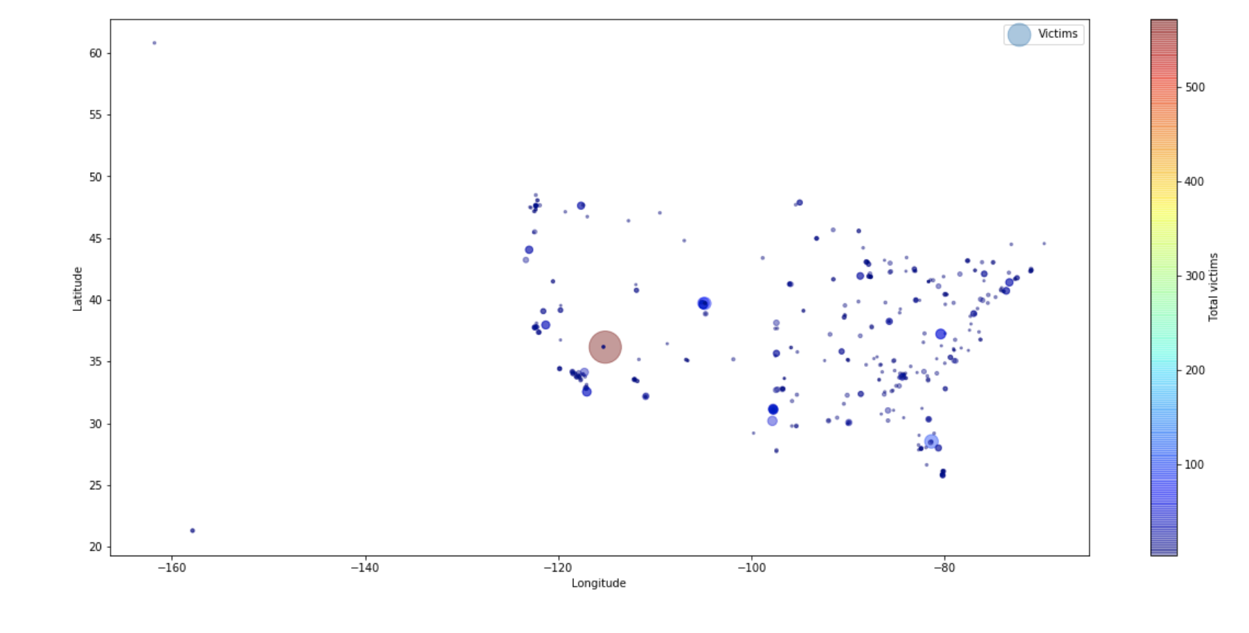
Original Visualization

Slide 3
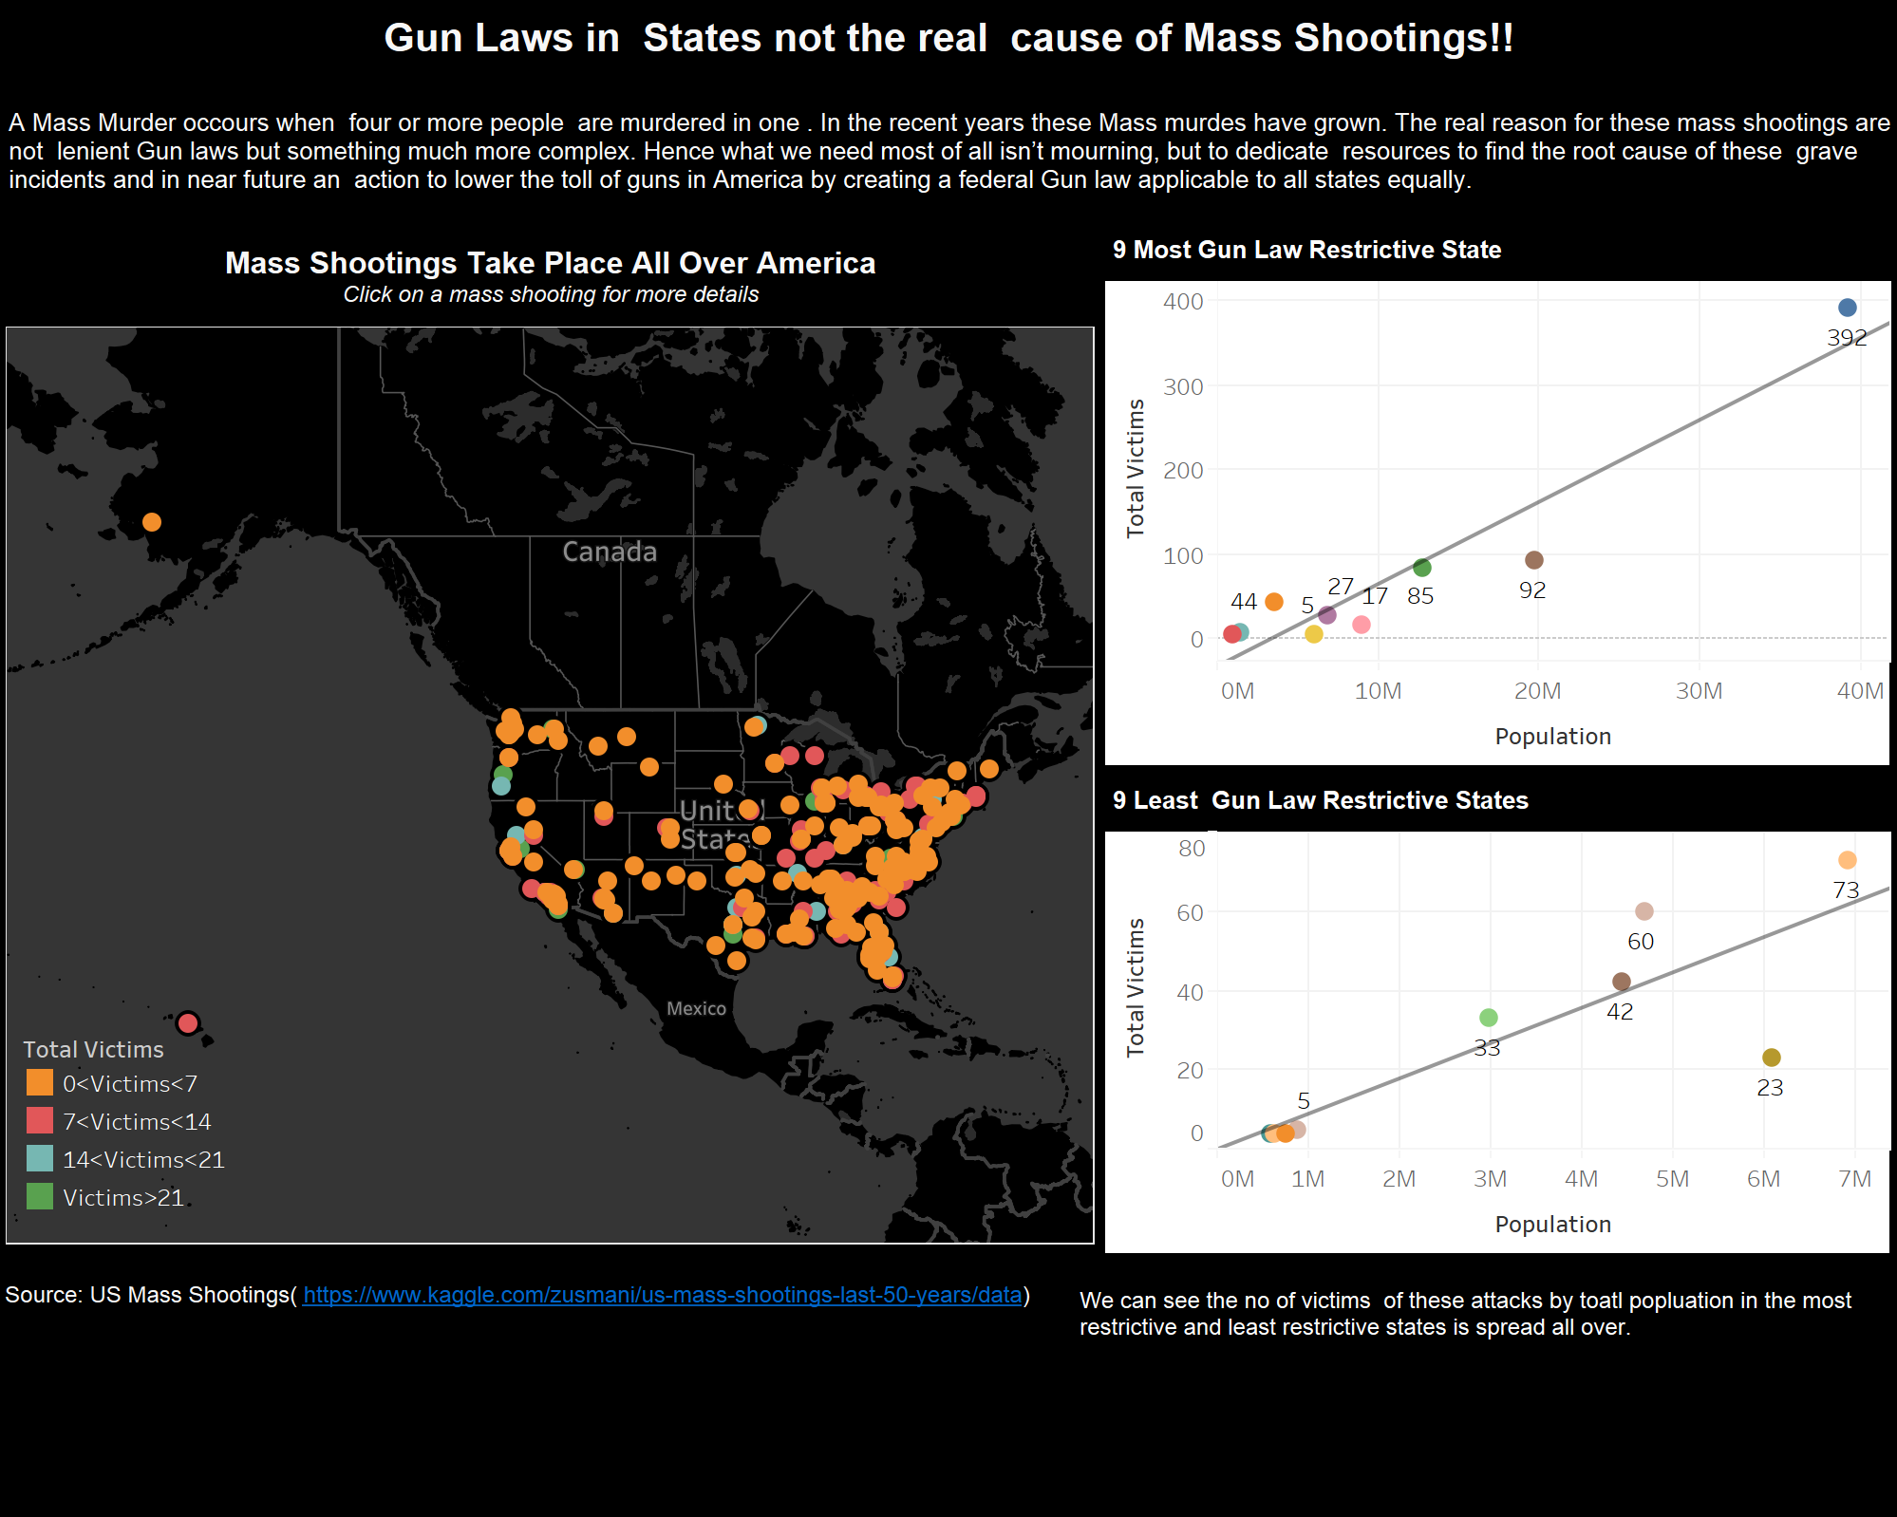

Slide 4
Thank You

